Slide 2
Stateflow
A state machine design tool integrated within Simulink:
Stateflow produces Simulink blocks, fed with Simulink inputs and producing Simulink outputs,
a Stateflow block can “execute” Simulink blocks as actions, provides a seamless integration of state machines into a block diagram formalism.

Slide 3
Stateflow features
Several features are worth to be noticed:
Stateflow encompasses both Mealy and Moore machines:
– actions associated with both states and transitions,
– entry actions performed when entering a state,
– during actions, performed when remaining in the state,
– exit actions, performed when leaving the state,
– condition actions, performed before leaving the source state,
– transition actions, performed after leaving the source state but before entering the destination state.

Slide 4
Stateflow features
Large variety of means for describing actions:
– event broadcasting,
– Stateflow scripts (assignments, etc.),
– truth tables,
– Simulink block “execution”,
– Matlab functions.

Slide 5
Subsystem in Stateflow
Design an automaton with one boolean input and one boolean output such
that the output
is initially false
becomes true as soon as the input becomes true
stays true for ever as soon as it has become true once

Slide 6
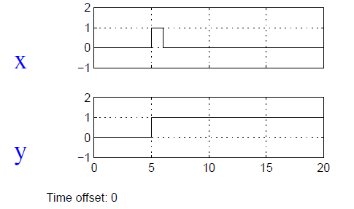
Stateflow

Slide 7
Stateflow
Shows how Stateflow integrates with Simulink

Slide 8
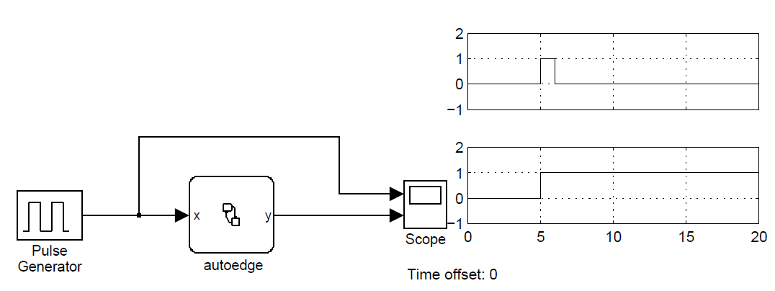
Stateflow

Slide 9
Monitoring properties

Slide 10
Stateflow and Simulink
The Stateflow data dictionary is the internal representation for the hierarchy of all Stateflow objects, graphical and nongraphical, that reside in a Simulink model. It is represented by the following diagram:

Slide 11
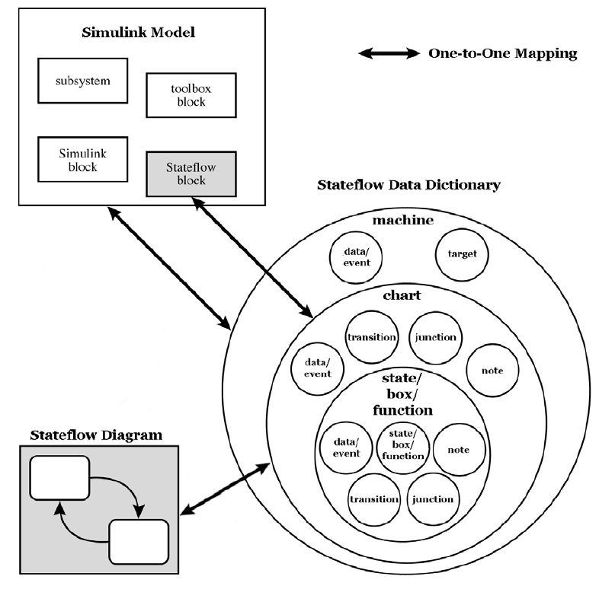
Stateflow and Simulink

Slide 12
Stateflow and Simulink
Each Stateflow block corresponds to a single Stateflow diagram. The Stateflow block interfaces to its Simulink model. The Stateflow block can interface to code sources external to the Simulink model (data, events, custom code).
Stateflow diagrams are event driven. Events can be local to the Stateflow block or can be propagated to and from Simulink and code sources external to Simulink. Data can be local to the Stateflow block or can be shared with and passed to the Simulink model and to code sources external to the Simulinkmodel.
You must define the interface to each Stateflow block. Defining the interface for a Stateflow block can involve some or all of these tasks:
Defining the Stateflow block update method
Defining Output to Simulink events
Adding and defining nonlocal events and nonlocal data within the Stateflow diagram
Defining relationships with any external sources

Slide 13
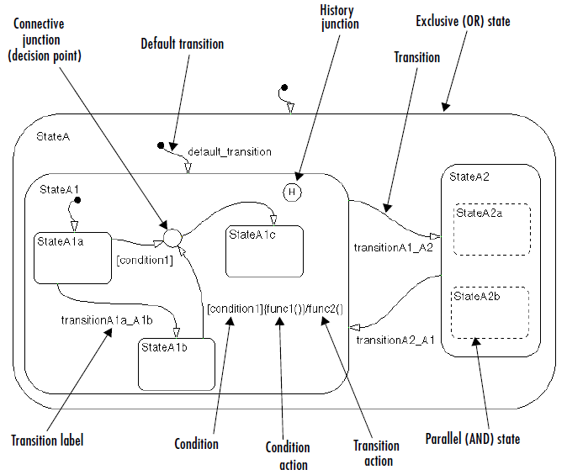
Elements of stateflow
The following sample Stateflow diagram displays the key graphical objects of a Stateflow diagram. These objects are described in following sections that refer to this diagram.

Slide 14
States
A state describes a mode of an event-driven system. The activity or inactivity of the states dynamically changes based on events and conditions.
Every state has a parent. In a Stateflow diagram consisting of a single state, that state’s parent is the Stateflow diagram itself (also called the Stateflow diagram root).
States have labels that can specify actions executed in a sequence based upon action type.
The action types are entry, during, exit, and on.

Slide 15
States
The decomposition of a state defines the kind of state that a state can contain and the next level of containment. Stateflow provides two types of states:
exclusive (OR) and parallel (AND) states.
Exclusive (OR) states are used to describe modes that are mutually exclusive. A chart or state that contains exclusive (OR) states is said to have exclusive decomposition.
A chart or state with parallel states has two or more states that can be active at the same time. A chart or state that contains parallel (AND) states is said to have parallel decomposition.
Parallel (AND) states are displayed as dashed rectangles. The activity of each parallel state is essentially independent of other states.

Slide 16
States

Slide 17
Transitions
A transition is a graphical object that, in most cases, links one object to another. One end of a transition is attached to a source object and the other end to a destination object.
The source is where the transition begins and the destination is where the transition ends.
A transition label describes the circumstances under which the system moves from one state to another.

Slide 18
Default transitions
Default transitions specify which exclusive (OR) state is to be active when there is ambiguity between two or more exclusive (OR) states at the same level in the hierarchy.
For example, the default transition to StateA1 resolves the ambiguity that exists with regard to whether StateA1 or StateA2 should be active when State A becomes active. In this case, when StateA is active, by default StateA1 is also active.
In the following Lights subsystem, the default transition to the Lights.Off substate indicates that when the Lights superstate becomes active, the Off substate becomes active by default.

Slide 19
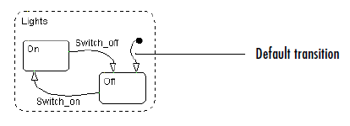
Default transitions

Slide 20
Events
Events drive the Stateflow diagram execution but are nongraphical objects and are thus not represented directly in a Stateflow chart. All events that affect the Stateflow diagram must be defined. The occurrence of an event causes the status of the states in the Stateflow diagram to be evaluated. The broadcast of an event can trigger a transition to occur or can trigger an action to be executed. Events are broadcast in a top-down manner starting from the event’s parent in the hierarchy.
Events are created and modified using the Stateflow Explorer. Events can be created at any level in the hierarchy. Events have properties such as a scope.
The scope defines whether the event is
Local to the Stateflow diagram
An input to the Stateflow diagram from its Simulink model
An output from the Stateflow diagram to its Simulink model
Exported to a (code) destination external to the Stateflow diagram and Simulink model
Imported from a code source external to the Stateflow diagram and Simulink
model

Slide 21
Data
Data objects are used to store numerical values for reference in the Stateflow diagram. They are nongraphical objects and are thus not represented directly in a Stateflow chart.
You create and modify data objects for Stateflow diagrams in Stateflow Explorer. Data objects have a property called scope that defines whether the data object is
Local to the Stateflow diagram
An input to the Stateflow diagram from its Simulink model
An output from the Stateflow diagram to its Simulink model
Nonpersistent temporary data
Defined in the MATLAB workspace
A constant
Exported to a (code) destination external to the Stateflow diagram and Simulink model
Imported from a code source external to the Stateflow diagram and Simulink model

Slide 22
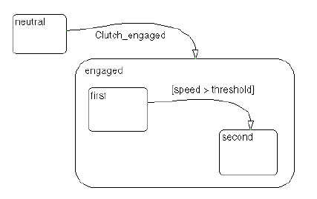
Condition
condition is a Boolean expression specifying that a transition occurs, given that the specified expression is true. In the component summary Stateflow diagram, [condition1] represents a Boolean expression that must be true for the transition to occur.
In the automatic transmission system, the transition from first to second occurs if the transition condition [speed > threshold] is true.

